Slide 1
Physical layer

Slide 2
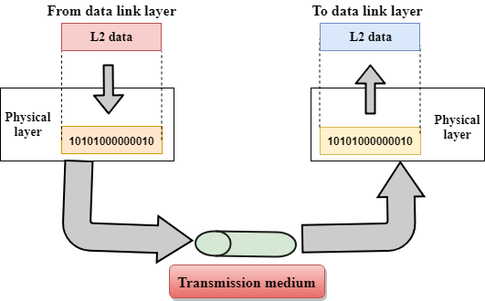
Physical layer is responsible for movements of individual bits from one hope to the next.

Slide 3
Physical layer
The physical layer coordinates the functions required to carry a bit stream over a physical medium. It deals with the mechanical and electrical specifications of the interface and transmission medium. It also defines the procedures and functions that physical devices and interfaces have to perform for transmission to occur. Figure below shows the position of the physical layer with respect to the transmission medium and the data link layer
The main functionality of the physical layer is to transmit the individual bits from one node to another node.
It establishes, maintains and deactivates the physical connection.

Slide 4
Functions of a Physical layer:
Line Configuration: It defines the way how two or more devices can be connected physically.
Data transmission: It defines the transmission mode whether it is simplex, half-duplex or full-duplex mode between the two devices on the network.
Topology: It defines the way how network devices are arranged.
Signals: It determines the type of the signal used for transmitting the information.

Slide 5
Network Devices (Connecting Devices)
We divide connecting devices into five different categories based on the layer in which they operate in a network, as shown in Figure below.
Application layer
Transport Layer
Network layer
Datalink layer
Physical layer
Gateway
Application layer
Transport Layer
Network layer
Datalink layer
Physical layer
Router or three-layer switch
Bridge or two-layer switch
Repeater or hub
Passive Hub

Slide 6
Circuit:
Circuit configuration:
Circuit configuration is the basic physical layout of the circuti. There are two fundamental configuration: point-to-point and multipoint.
Point to point:
A point-to-point connection provides a dedicated link between two devices.
The entire capacity of the link is reserved for transmission between those two devices.
Most point-to-point connections use an actual length of wire or cable to connect the two ends, but other options such as microwave or satellite links are also possible.
Point to point network topology is considered to be one of the easiest and most conventional networks
topologies.
It is also the simplest to establish and understand.

Slide 7
Multipoint:
Uses a single link to connect three or more devices
More complex than point-to-point configuration
Can be more efficient and cost-effective for larger networks
Devices share the same link, which can lead to collisions and lower performance
Commonly used in LANs and MANs

Slide 8
Data Flow:
Circiuti can be designed to permit dat ato flow in one direction or in both dierections. Actually , there are three ways to transmit: simplex,halfdulpex, and full-duplex.
1. Simplex Mode –
In Simplex mode, the communication is unidirectional, as on a one-way street. Only one of the two devices on a link can transmit, the other can only receive. The simplex mode can use the entire capacity of the channel to send data in one direction.
Example: Keyboard and traditional monitors. The keyboard can only introduce input, the monitor can only give the output.

Slide 9
Advantages:
Simplex mode is the easiest and most reliable mode of communication.
It is the most cost-effective mode, as it only requires one communication channel.
There is no need for coordination between the transmitting and receiving devices, which simplifies the communication process.
Simplex mode is particularly useful in situations where feedback or response is not required, such as broadcasting or surveillance.
Disadvantages:
Only one-way communication is possible.
There is no way to verify if the transmitted data has been received correctly.
Simplex mode is not suitable for applications that require bidirectional communication.

Slide 10
2. Half-Duplex Mode –
In half-duplex mode, each station can both transmit and receive, but not at the same time. When one device is sending, the other can only receive, and vice versa. The half-duplex mode is used in cases where there is no need for communication in both directions at the same time. The entire capacity of the channel can be utilized for each direction.
Example: Walkie-talkie in which message is sent one at a time and messages are sent in both directions.
Advantages:
Half-duplex mode allows for bidirectional communication, which is useful in situations where devices need to send and receive data.
It is a more efficient mode of communication than simplex mode, as the channel can be used for both transmission and reception.
Half-duplex mode is less expensive than full-duplex mode, as it only requires one communication channel.
Disadvantages:
Half-duplex mode is less reliable than Full-Duplex mode, as both devices cannot transmit at the same time.
There is a delay between transmission and reception, which can cause problems in some applications.
There is a need for coordination between the transmitting and receiving devices, which can complicate the communication process.

Slide 11
3. Full-Duplex Mode –
In full-duplex mode, both stations can transmit and receive simultaneously. In full_duplex mode, signals going in one direction share the capacity of the link with signals going in another direction, this sharing can occur in two ways:
Either the link must contain two physically separate transmission paths, one for sending and the other for receiving.
Or the capacity is divided between signals traveling in both directions.

Slide 12
Advantages:
Full-duplex mode allows for simultaneous bidirectional communication, which is ideal for real-time applications such as video conferencing or online gaming.
It is the most efficient mode of communication, as both devices can transmit and receive data simultaneously.
Full-duplex mode provides a high level of reliability and accuracy, as there is no need for error correction mechanisms.
Disadvantages:
Full-duplex mode is the most expensive mode, as it requires two communication channels.
It is more complex than simplex and half-duplex modes, as it requires two physically separate transmission paths or a division of channel capacity.
Full-duplex mode may not be suitable for all applications, as it requires a high level of bandwidth and may not be necessary for some types of communication.

Slide 13
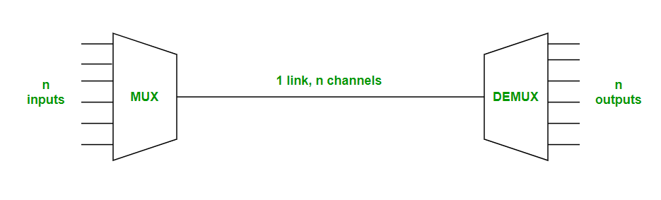
Multiplexing:
Multiplexing is the sharing of a medium or bandwidth. It is the process
in which multiple signals coming from multiple sources are combined
and transmitted over a single communication/physical line.
Types of Multiplexing
There are three types of Multiplexing :
Frequency Division Multiplexing (FDM)
Time-Division Multiplexing (TDM)
Wavelength Division Multiplexing (WDM)

Slide 14
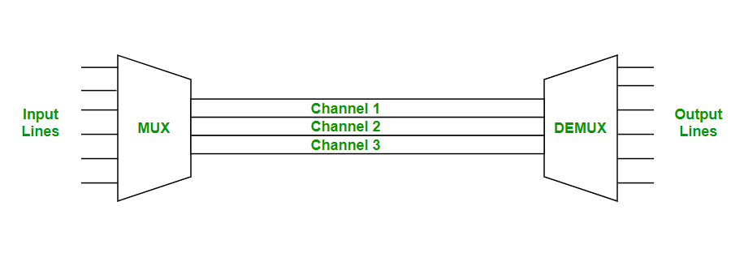
Frequency Division Multiplexing is used in radio and television transmission.
In FDM, we can observe a lot of inter-channel cross-talk, due to the fact that in this type of multiplexing the bandwidth is divided into frequency channels. In order to prevent the inter-channel cross talk, unused strips of bandwidth must be placed between each channel. These unused strips between each channel are known as guard bands.
FDM:
Frequency division multiplexing is defined as a type of multiplexing where the bandwidth of a single physical medium is divided into a number of smaller, independent frequency channels.

Slide 15
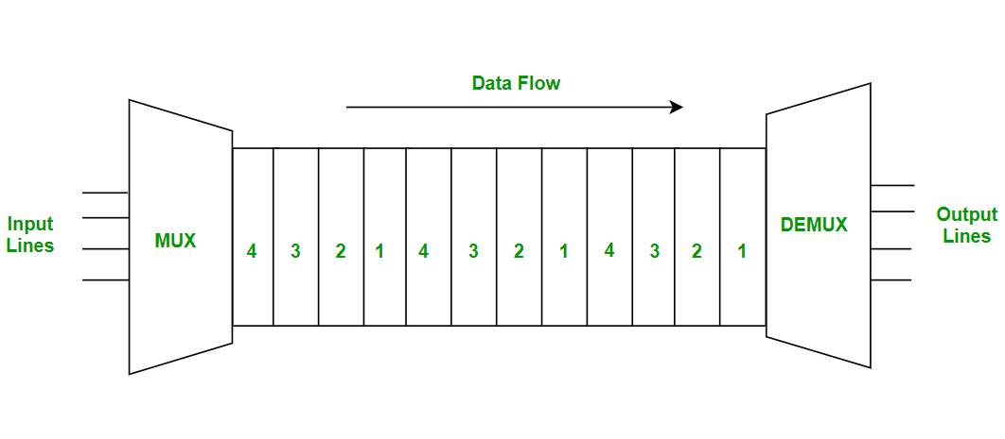
Time Division Multiplexing :
Time-division multiplexing is defined as a type of multiplexing wherein FDM, instead of sharing a portion of the bandwidth in the form of channels, in TDM, time is shared. Each connection occupies a portion of time in the link.
In Time Division Multiplexing, all signals operate with the same frequency (bandwidth) at different times.

Slide 16
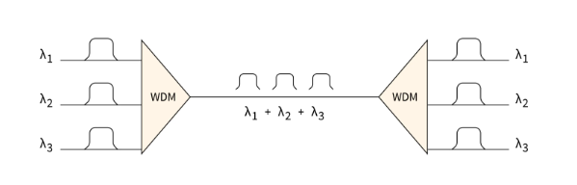
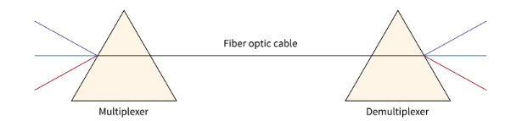
Wavelenght Division:
Wavelength Division Multiplexing (WDM) is used in fiber optics to increase the capacity of a single fiber.
In Wavelength Division Multiplexing, various light waves from different sources are merged into a composite light signal, and then transmitted across the channel to the receiver.
It is an analog multiplexing approach and very much similar to FDM.
In WDM, Prisms are used to combine and split light waves. This prism assists in bending the light beam according to the angle of incidence and frequency of the light.

Slide 17
Transmission media
For any networking to be effective ,raw stream of data to be transported from one device to other over some medium. Various media can be used for transfer data.
Transmission media
Guided
unguided
Coaxial
Fiber Optics
Twisted
Radio Signal
Microwaves
Infrared
Baseband
Unshielded Twisted Pair (UTP)
Broadband
Shielded Twisted Pair (STP)

Slide 18
Guided Media:
In this the data is transmitted through cabling system that has a
Fixed path
Features:
High Speed
Secure
Used for comparatively shorter distances

Slide 19
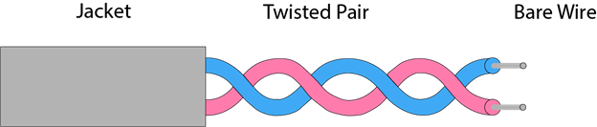
There are 3 major types of Guided Media
Twisted pair:
Twisted pair is a physical media made up of a pair of cables twisted with each other.
A twisted pair cable is cheap as compared to other transmission media.
Installation of the twisted pair cable is easy
The frequency range for twisted pair cable is from 0 to 3.5KHz.
A twisted pair consists of two insulated copper wires arranged in a regular spiral pattern.

Slide 20
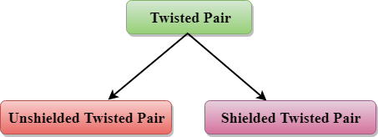
Types of Twisted pair:
Unshielded Twisted Pair:
A unshielded twisted pair widely used in telecommunication. Following are the categories of the unshielded twisted pair cable:
Category 1: Category 1 is used for telephone lines that have low-speed data.
Category 2: It can support upto 4Mbps.

Slide 21
Category 3: It can support upto 10 Mbps for upto 100 meters.
Category 4: It is used in token ring network. It support 16 Mbps upto 100 meters.
Category 5: It is used in Ethernet based lan. It contains two twisted pair.It supports 100Mbps for upto 100 meters.
Category 5e: It is used in Ethernet based lan. CAT5e contains four twisted pairs. It support 1Gbps for 100 meters.
Category 6: Used in Ethernet based lan and data center network.It contains four tightly wound twisted pair. It support 1Gbps for upto 100 meters and 10 Gbps for up to 50 meters.

Slide 22
Advantage:
It is cheap
Installation is easy
It can be used for high speed lan
Disadvantage:
This cable can only be used for shorter distance because of attenuation.

Slide 23
Shielded Twisted Pair:
A shielded twisted pair is a cable that contains the mesh surrounding the wire that allows the higher transmission rate.
Characteristics Of Shielded Twisted Pair:
The cost of the shielded twisted pair cable is not very high and not very low.
An installation of STP is easy.
It has higher capacity as compared to unshielded twisted pair cable.
It has a higher attenuation.
It is shielded that provides the higher data transmission rate.
Disadvantages:
It is more expensive as compared to UTP and coaxial cable.
It has a higher attenuation rate.

Slide 24
Coaxial Cable
Coaxial cable is very commonly used transmission media, for example, TV wire is usually a coaxial cable.
The name of the cable is coaxial as it contains two conductors parallel to each other.
It has a higher frequency as compared to Twisted pair cable.
The inner conductor of the coaxial cable is made up of copper, and the outer conductor is made up of copper mesh. The middle core is made up of non-conductive cover that separates the inner conductor from the outer conductor.
The middle core is responsible for the data transferring whereas the copper mesh prevents from the EMI(Electromagnetic interference)

Slide 25
Coaxial cable is of two types:
Baseband transmission: It is defined as the process of transmitting a single signal at high speed.
Broadband transmission: It is defined as the process of transmitting multiple signals simultaneously.
Advantages Of Coaxial cable:
The data can be transmitted at high speed.
It has better shielding as compared to twisted pair cable.
It provides higher bandwidth.
Disadvantages Of Coaxial cable:
It is more expensive as compared to twisted pair cable.
If any fault occurs in the cable causes the failure in the entire network.

Slide 26
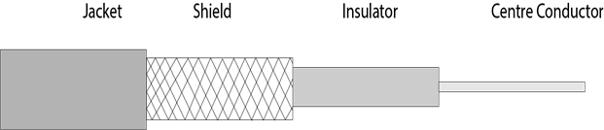

Slide 27
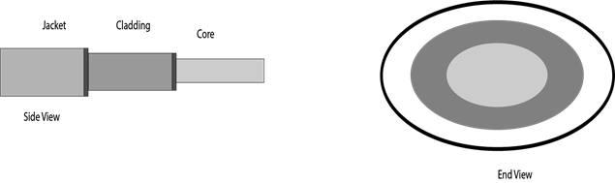
Fiber optics:
Fibre optic cable is a cable that uses electrical signals for communication.
Fibre optic is a cable that holds the optical fibres coated in plastic that are used to send the data by pulses of light.
The plastic coating protects the optical fibres from heat, cold, electromagnetic interference from other types of wiring.
Fibre optics provide faster data transmission than copper wires.
Diagrammatic representation of fibre optic cable:

Slide 28
Core: The optical fibre consists of a narrow strand of glass or plastic known as a core. A core is a light transmission area of the fibre. The more the area of the core, the more light will be transmitted into the fibre.
Cladding: The concentric layer of glass is known as cladding. The main functionality of the cladding is to provide the lower refractive index at the core interface as to cause the reflection within the core so that the light waves are transmitted through the fibre.
Jacket: The protective coating consisting of plastic is known as a jacket. The main purpose of a jacket is to preserve the fibre strength, absorb shock and extra fibre protection.
Advantage:
Greater Bandwidth: The fibre optic cable provides more bandwidth as compared copper. Therefore, the fibre optic carries more data as compared to copper cable.
Faster speed: Fibre optic cable carries the data in the form of light. This allows the fibre optic cable to carry the signals at a higher speed.
Longer distances: The fibre optic cable carries the data at a longer distance as compared to copper cable.

Slide 29
Fiber Cable Standards:
Optical Fiber cables can support high bit rates, up to Gbps.
has very low signal attenuation
Generally for a travelling light ray, reflection takes place .The bent of light ray at the interface is the result of difference in the speed.
Types of Fiber optics: Generally optical fiber is classified into two categories based on: the number of modes, and the refractive index. These are explained as following below.
1. On the basis of the Number of Modes: It is classified into 2 types:
(a). Single-mode fiber: In single-mode fiber, only one type of ray of light can propagate through the fiber. This type of fiber has a small core diameter (5um) and high cladding diameter (70um) and the difference between the refractive index of core and cladding is very small. There is no dispersion i.e. no degradation of the signal during traveling through the fiber. The light is passed through it through a laser diode.

Slide 30
b). Multi-mode fiber: Multimode fiber allows a large number of modes for the light ray traveling through it. The core diameter is generally (40um) and that of cladding is (70um). The relative refractive index difference is also greater than single mode fiber.There are two categories on the basis of Multi-mode fiber i.e.Step Index Fiber and Graded Index Fiber.Basically these
a). Step-index optical fiber: The refractive index of core is constant. The refractive index of the cladding is also constant. The rays of light propagate through it in the form of meridional rays which cross the fiber axis during every reflection at the core-cladding boundary.

Slide 31
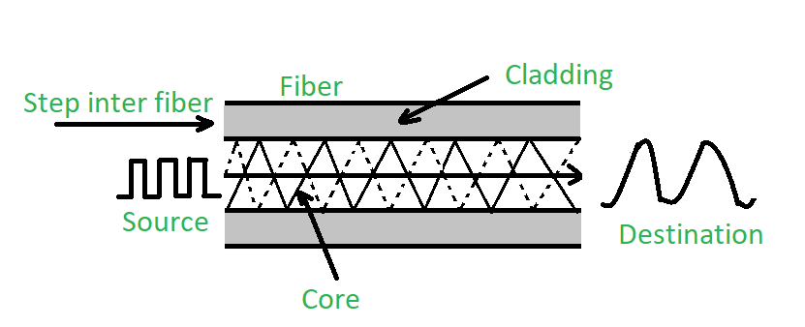
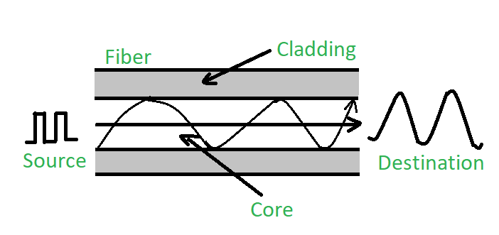
Graded index optical fiber: In this type of fiber, the core has a non-uniform refractive index that gradually decreases from the center towards the core-cladding interface.

Slide 32
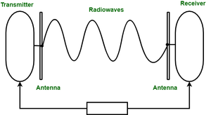
Radio Waves:
Radio waves are the electromagnetic waves that are transmitted in all the direction of free space.
Radio waves are omnidirectional
The range in frequency of radio waves in form 3khz to 1Ghz.
The wave sent by the sending antenna can be received by any receiving antenna.
An example of radio waves is FM radio, television, cellular phones and wireless LAN.

Slide 33
Microwaves:
Microwaves are electromagnetic waves which have frequency range between 1 GHz to 1000 GHz. These can travel along long distances. These are unidirectional in nature which means that they can travel only in straight line.
Characteristics of Microwave:
Bandwidth: It supports the bandwidth from 1 to 10 Mbps.
Short distance: It is inexpensive for short distance.
Long distance: It is expensive as it requires a higher tower for a longer distance.
Attenuation: Attenuation means loss of signal. It is affected by environmental conditions and antenna size.
Microwaves are of two types:
Terrestrial microwave
Satellite microwave communication.

Slide 34
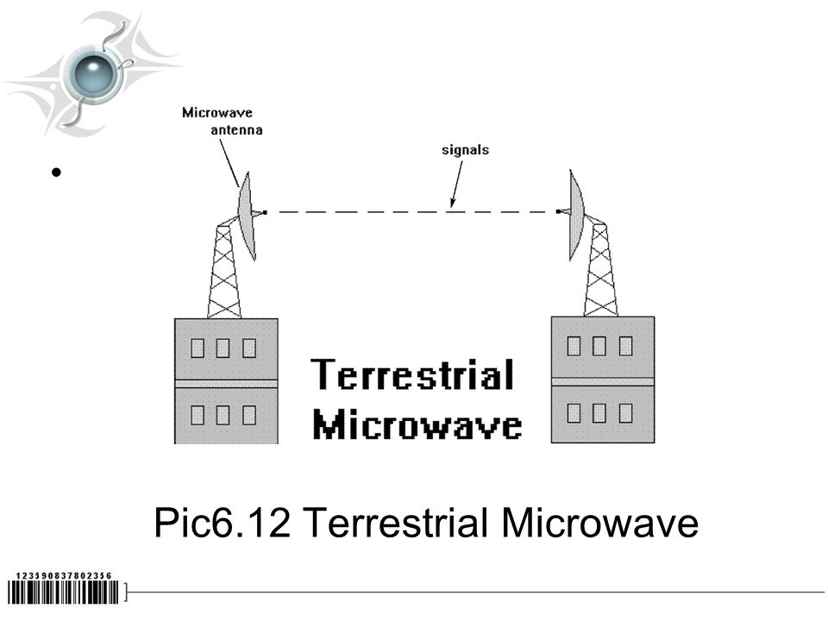
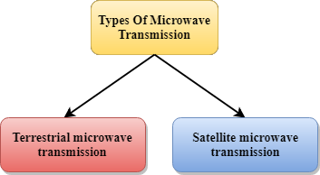
Terrestrial microwave:
Terrestrial Microwave transmission is a technology that transmits the focused beam of a radio signal from one ground-based microwave transmission antenna to another.
In this case, antennas are mounted on the towers to send a beam to another antenna which is km away.
It works on the line of sight transmission, i.e., the antennas mounted on the towers are the direct sight of each other.

Slide 35
Satellite Microwave Communication
A satellite is a physical object that revolves around the earth at a known height.
Satellite communication is more reliable nowadays as it offers more flexibility than cable and fibre optic systems.
We can communicate with any point on the globe by using satellite communication.
How Does Satellite work?
The satellite accepts the signal that is transmitted from the earth station, and it amplifies the signal. The amplified signal is retransmitted to another earth station.

Slide 36
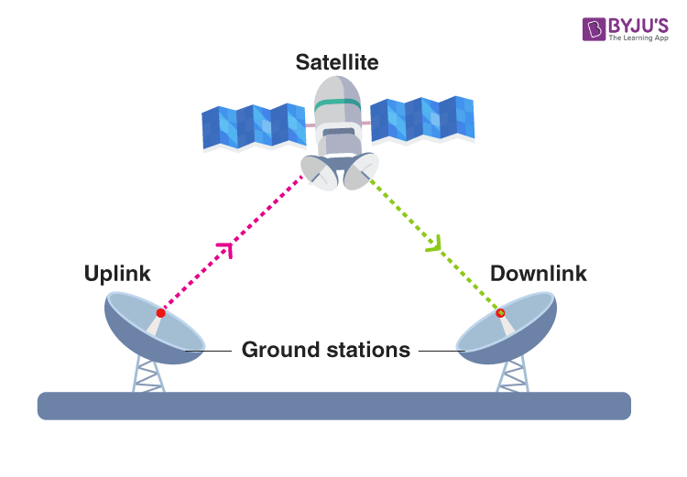
Advantages Of Satellite Microwave Communication:
The coverage area of a satellite microwave is more than the terrestrial microwave.
The transmission cost of the satellite is independent of the distance from the centre of the coverage area.
Satellite communication is used in mobile and wireless communication applications.
It is used in a wide variety of applications such as weather forecasting, radio/TV signal broadcasting, mobile communication, etc.

Slide 37
Disadvantages Of Satellite Microwave Communication:
Satellite designing and development requires more time and higher cost.
The Satellite needs to be monitored and controlled on regular periods so that it remains in orbit.
The life of the satellite is about 12-15 years. Due to this reason, another launch of the satellite has to be planned before it becomes non-functional.

Slide 38
Infrared
An infrared transmission is a wireless technology used for communication over short ranges.
The frequency of the infrared in the range from 300 GHz to 400 THz.
It is used for short-range communication such as data transfer between two cell phones, TV remote operation, data transfer between a computer and cell phone resides in the same closed area.
Characteristics Of Infrared:
It supports high bandwidth, and hence the data rate will be very high.
An infrared communication provides better security with minimum interference.
Infrared communication is unreliable outside the building because the sun rays will interfere with the infrared waves.

Slide 39
Digital transmission of Digital Data
All computer systems produce binary data. For these data to be understood by both the sender and receiver, both must agree on a standard system for representing the letters, numbers, and symbols that compose messages. The coding scheme is the language that computers use to represent data.
Codes
A character is a symbol that has a common, constant meaning. A character might be the letter A or B, or it might be a number such as 1 or 2. Characters also may be special symbols such as ? or &. Characters in data communications, as in computer systems, are represented by groups of bits that are binary zeros (0) and ones (1). The groups of bits representing the set of characters that are the "alphabet" of any given system are called a coding scheme, or simply a code.
A byte is a group of consecutive bits that is treated as a unit or character. One byte normally is composed of 8 bits and usually represents one character; however, in data communications, some codes use 5, 6, 7, 8, or 9 bits to represent a character. For example, representation of the character A by a group of 8 bits (say, 01 000 001) is an example of coding.

Slide 40
There are three predominant coding schemes in use today. United States of America Standard Code for Information Interchange (USASCII, or, more commonly, ASCII) is the most popular code for data communications and is the standard code on most microcomputers. There are two types of ASCII; one is a seven-bit code that has 128 valid character combinations, and the other is an eight-bit code that has 256 combinations. The number of combinations can be determined by taking the number 2 and raising it to the power equal to the number of bits in the code because each bit has two possible values, a 0 or a 1. In this case 2⁷ = 128 characters or 2⁸ = 256 characters.
A second commonly used coding scheme is ISO 8859, which is standardized by the International Standards Organization, ISO 8859 is an eight-bit code that includes the ASCII codes plus non-English letters used by many European languages (e.g., letters with acents).
Unicode is the other commonly used coding scheme. There are many different versions of Unicode. UTF-8 is an eight-bit version which is very similar to ASCII. UTF-16, which uses 16-bits per character (i.e. two bytes, called a "word"), is used by Windows. By using more bits, UTF-16 can represent many more characters beyond the usual English or Latin characters, such as Cyrillic or Chinese.

Slide 41
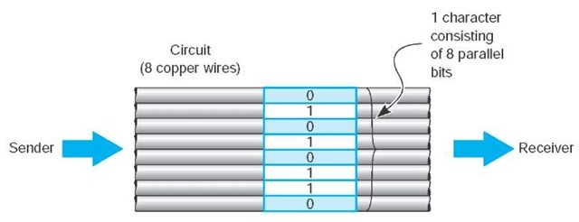
Transmission Modes
Parallel transmission is the way the internal transfer of binary data takes place inside a computer. If the internal structure of the computer is eight-bit, then all eight bits of the data element are transferred between main memory and the central processing unit simultaneously on eight separate connections. The same is true of computers that use a 32-bit structure; all 32 bits are transferred simultaneously on 32 connections.

Slide 42
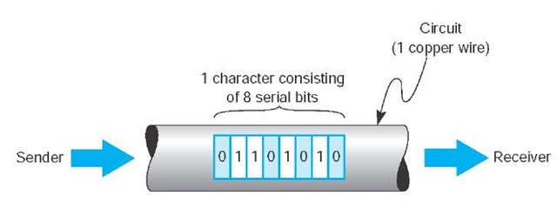
Serial transmission means that a stream of data is sent over a communication circuit sequentially in a bit-by-bit fashion as shown in Figure 3.17. In this case, there is only one physical wire inside the bundle and all data must be transmitted over that one physical wire. The transmitting device sends one bit, then a second bit, and so on, until all the bits are transmitted. It takes n iterations or cycles to transmit n bits. Thus, serial transmission is considerably slower than parallel transmission—eight times slower in the case of 8-bit ASCII (because there are 8 bits)..

Slide 43
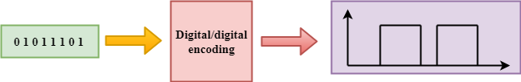
Digital Transmission
Digital transmission is the transmission of binary electrical or light pulses in that it only has two possible states, a 1 or a 0.
All digital transmission techniques require a set of symbols (to define how to send a 1 and a 0), and the symbol rate (how many symbols will be sent per second).
DIGITAL-TO-DIGITAL CONVERSION
Digital-to-digital encoding is the representation of digital information by a digital signal. When binary 1s and 0s generated by the computer are translated into a sequence of voltage pulses that can be propagated over a wire, this process is known as digital-to-digital encoding.

Slide 44
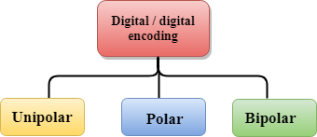
Digital-to-digital encoding is divided into three categories:
Unipolar
Digital transmission system sends the voltage pulses over the medium link such as wire or cable.
In most types of encoding, one voltage level represents 0, and another voltage level represents 1.
The polarity of each pulse determines whether it is positive or negative.
This type of encoding is known as Unipolar encoding as it uses only one polarity.
In Unipolar encoding, the polarity is assigned to the 1 binary state.
In this, 1s are represented as a positive value and 0s are represented as a zero value.
In Unipolar Encoding, '1' is considered as a high voltage and '0' is considered as a zero voltage.
Unipolar encoding is simpler and inexpensive to implement.

Slide 45
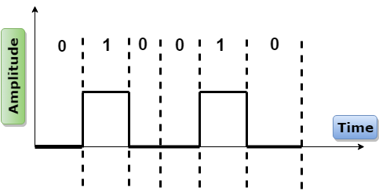
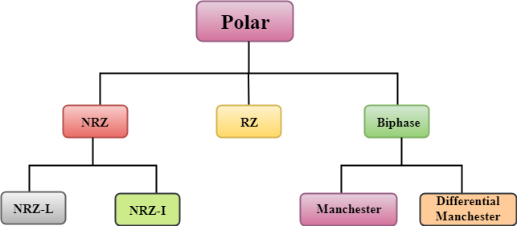
Polar
Polar encoding is an encoding
scheme that uses two
voltage levels: one is
positive, and another is
negative.

Slide 46
NRZ
NRZ stands for Non-return zero.In NRZ encoding, the level of the signal can be represented either positive or negative.
The two most common methods used in NRZ are:
NRZ-L: In NRZ-L encoding, the level of the signal depends on the type of the bit that it represents. If a bit is 0 or 1, then their voltages will be positive and negative respectively. Therefore, we can say that the level of the signal is dependent on the state of the bit.
NRZ-I: NRZ-I is an inversion of the voltage level that represents 1 bit. In the NRZ-I encoding scheme, a transition occurs between the positive and negative voltage that represents 1 bit. In this scheme, 0 bit represents no change and 1 bit represents a change in voltage level.

Slide 47
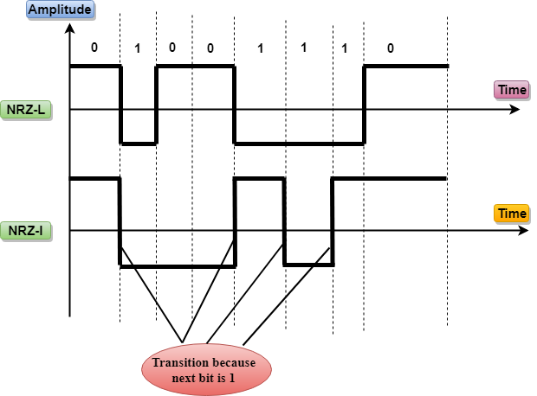
0-hero
1-zero
0-no transition
1-transition

Slide 48
RZ
RZ stands for Return to zero.
There must be a signal change for each bit to achieve synchronization. However, to change with every bit, we need to have three values: positive, negative and zero.
RZ is an encoding scheme that provides three values, positive voltage represents 1, the negative voltage represents 0, and zero voltage represents none.
In the RZ scheme, halfway through each interval, the signal returns to zero.
In RZ scheme, 1 bit is represented by positive-to-zero and 0 bit is represented by negative-to-zero.

Slide 49
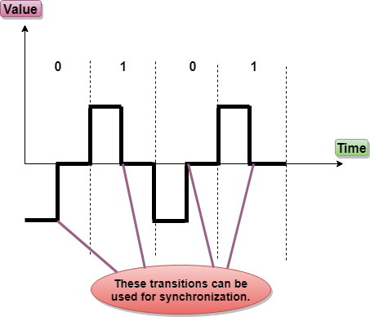
1-straight z above the reference line
0-inverse z below the reference line

Slide 50
Biphase
Biphase is an encoding scheme in which signal changes at the middle of the bit interval but does not return to zero.
Biphase encoding is implemented in two different ways:
Manchester
It changes the signal at the middle of the bit interval but does not return to zero for synchronization.
In Manchester encoding, a negative-to-positive transition represents binary 1, and positive-to-negative transition represents 0.
Manchester has the same level of synchronization as RZ scheme except that it has two levels of amplitude.
Differential Manchester
It changes the signal at the middle of the bit interval for synchronization, but the presence or absence of the transition at the beginning of the interval determines the bit. A transition means binary 0 and no transition means binary 1.

Slide 51
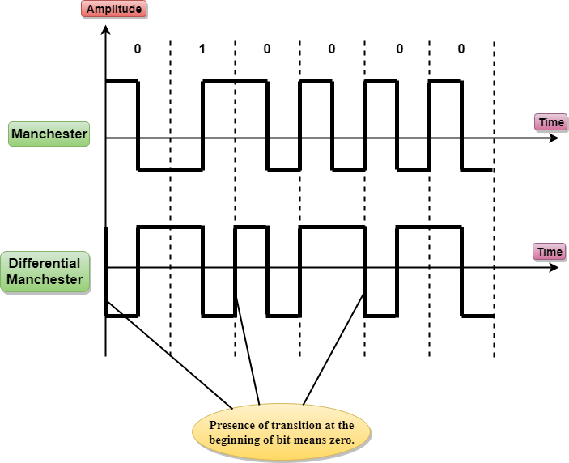
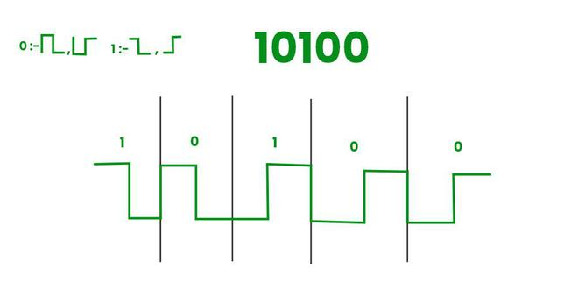
1-negative to positive transition
0-positive to negative transition
either 0 or 1 first transition is from negative to positive
then
0-transition
1-no transition
Differential Manchaster

Slide 52
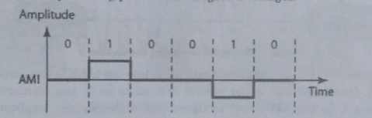
Bipolar Encoding
BIpolar encoding uses three voltage levels,positive,negative and zero. Zero voltage represents binary 0 and bit 1 is represented by altering positive and negative voltage.

Slide 53
Analog transmission of digital data
Analog transmission of digital data refers to the process of transmitting digital information which is typically represented as discrete 0's and 1's over an analog communication channel.Converting the binary digital data into analog signals that can be transmitted over various transmission medium , such as copper cables, radio wavs, or optical fibers.
Modulation:
The process by which data/information is converted into electrical/digital signals for transferring that signal over a medium is called modulation. It increases strength for maximum reach of the signals. The process of extracting information/data from the transmitted signal is called demodulation. A Modem is a device that performs both modulation and demodulation processes. The various forms of modulation are designed to alter the characteristic of carrier waves. The most commonly altered characteristics of modulation include amplitude, frequency, and phase.

Slide 54
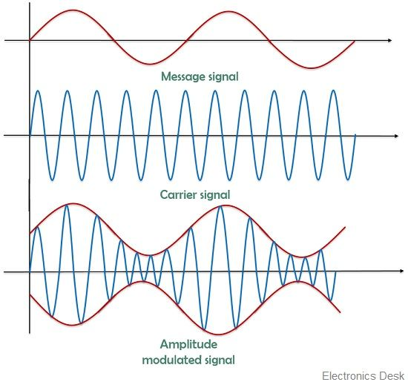
Types of modulation:
1. Amplitude modulation: The process of superimpposing the message signal over carrier waves to change the amplitude is called amplitude modulation.

Slide 55
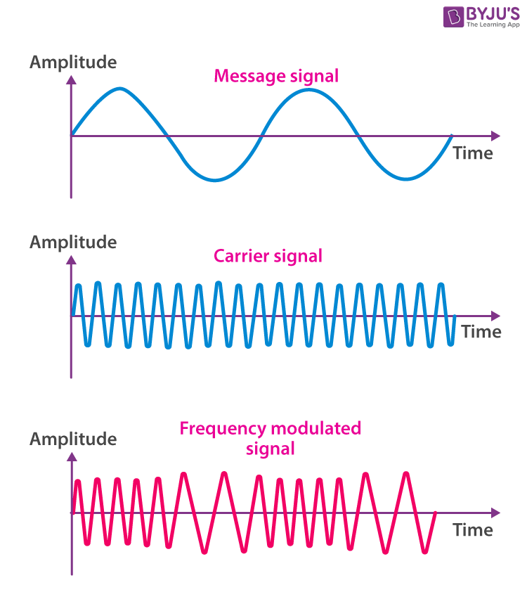
2. Frequency modulation
The process of superimposing the message signal over carrier wave to change in frequency is called frequency modulation.

Slide 56
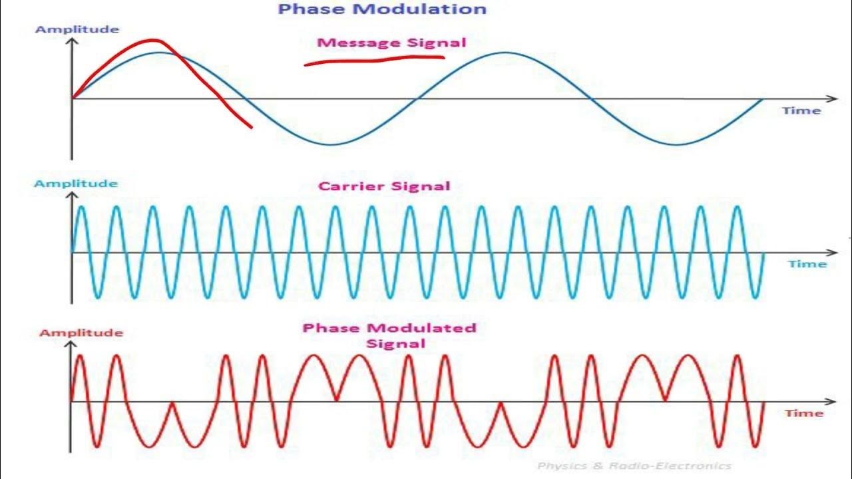
3. Phase modulation:
The process of superimposing the message signal over carrier wave to change in phase is called phase modulation.

Slide 57
How Modems Transmit Data
The modem (modulator/demodulator) takes the digital data from a computer in the form of electrical pulses and converts them into the analog signal that is needed for transmission over an analog voice-grade circuit. There are many different types of modems available today from dial-up modems to cable modems. For data to be transmitted between two computers using modems, both need to use the same type of modem. Fortunately, several standards exist for modems, and any modem that conforms to a standard can communicate with any other modem that conforms to the same standard.

Slide 58
Digital transmission of analog data
In the same way that digital computer data can be sent over analog telephone networks using analog transmission, analog voice data can be sent over digital networks using digital transmission. This process is somewhat similar to the analog transmission of digital data. A pair of special devices called codecs {code!decode) is used in the same way that a pair of modems is used to translate the data to send across the circuit. One codec is attached to the source of the signal (e.g., a telephone or the local loop at the end office) and translates the incoming analog voice signal into a digital signal for transmission across the digital circuit. A second codec at the receiver’s end translates the digital data back into analog data.
Techniques of Analog-to-Digital Conversion
The following techniques can be used for Analog to Digital Conversion –
a. PULSE CODE MODULATION
The most common technique to change an analog signal to digital data is called pulse code modulation (PCM). A PCM encoder has the following three processes
Sampling
Quantization
Encoding

Slide 59
Sampling: The first step in ADC is sampling, where the continuous analog signal is measured at discrete intervals. The rate at which these samples are taken is known as the sampling rate, and it is crucial to accurately represent the original analog signal. According to the Nyquist-Shannon sampling theorem, the sampling rate must be at least twice the highest frequency component of the analog signal to avoid aliasing (under smpling).
Quantization: Once the analog signal is sampled, the next step is quantization. During quantization, each sample's amplitude is rounded or truncated to the nearest available digital value. The number of bits used for this representation determines the resolution of the ADC. Higher bit resolutions result in more accurate representation but also require more data storage and processing power.
Encoding: The quantized values are then encoded into digital representations using binary code. This process assigns a unique binary code to each quantized amplitude level.

Slide 60
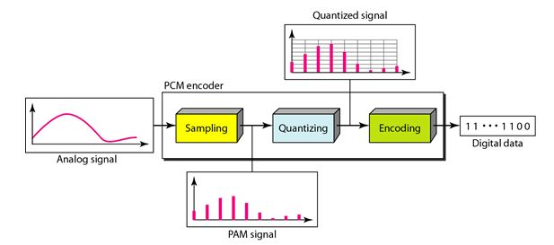

Slide 61
b. DELTA MODULATION :
Since PCM is a very complex technique, other techniques have been developed to reduce the complexity of PCM. The simplest is delta Modulation.
The modulator is used at the sender site to create a stream of bits from an analog signal. The process records a small positive change called delta. If the delta is positive, the process records a 1 else the process records a 0. The modulator builds a second signal that resembles a staircase. The input signal is then compared with this gradually made staircase signal.

Slide 62
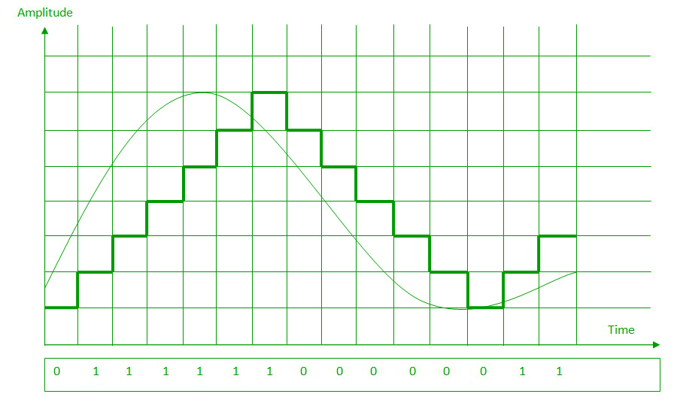
We have the following rules for output:
If the input analog signal is higher than the last value of the staircase signal, increase delta by 1, and the bit in the digital data is 1.
If the input analog signal is lower than the last value of the staircase signal, decrease delta by 1, and the bit in the digital data is 0.

Slide 63
How Telephones Transmit Voice Data
When you make a telephone call, the telephone converts your analog voice data into a simple analog signal and sends it down the circuit from your home to the telephone company’s network. This process is almost unchanged from the one used by Bell when he invented the telephone in 1876. With the invention of digital transmission, the common carriers (i.e., the telephone companies) began converting their voice networks to use digital transmission. Today, all of the common carrier networks use digital transmission, except in the local loop (sometimes called the last mile), the wires that run from your home or business to the telephone switch that connects your local loop into the telephone network. This switch contains a codec that converts the analog signal from your phone into a digital signal. This digital signal is then sent through the telephone network until it hits the switch for local loop for the person you are calling. This switch uses its codec to convert the digital signal used inside the phone network back into the analog signal needed by that person’s local loop and telephone.

Slide 64
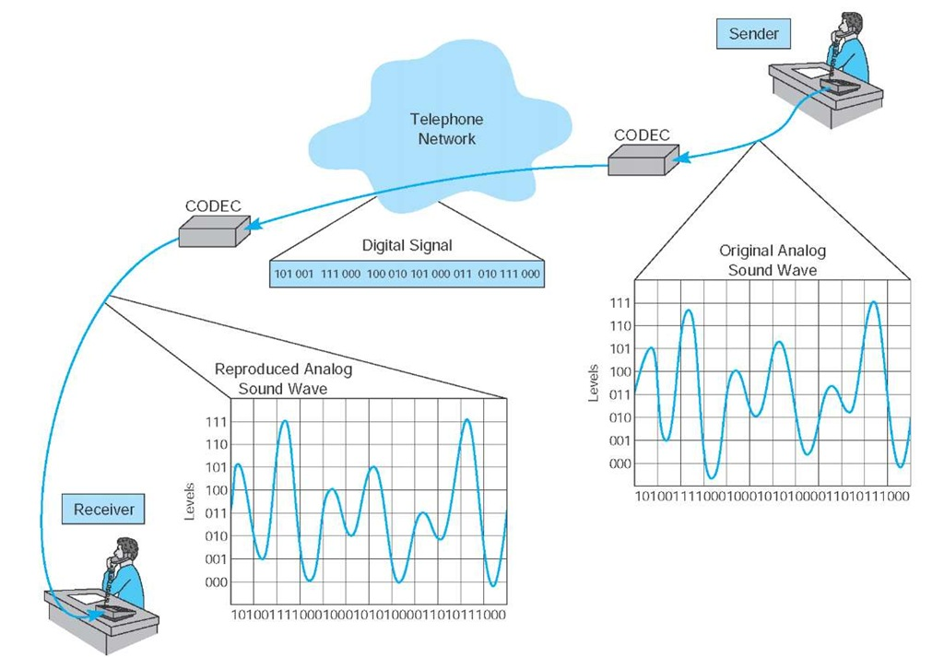

Slide 65
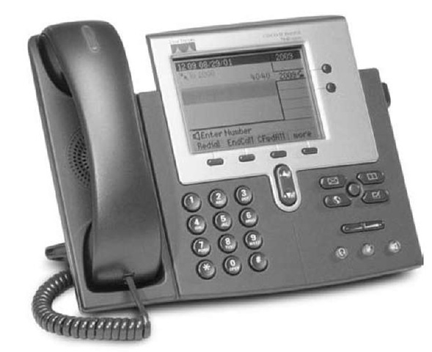
Voice over Internet Protocol (VoIP)
Voice over Internet Protocol (VoIP, pronounced voyp) is commonly used to transmit phone conversations over digital networks. VoIP is a relatively new standard that uses digital telephones with built-in codecs to convert analog voice data into digital data (see Figure 3.26).

Slide 66
Because the codec is built into the telephone, the telephone transmits digital data and therefore can be connected directly into a Local Area Network, in much the same manner as a typical computer. Because VoIP phones operate on the same networks as computers, we can reduce the amount of wiring needed; with VoIP, we need to operate and maintain only one network throughout our offices, rather than two separate networks—one for voice and one for data. However, this also means that data networks with VoIP phones must be designed to operate in emergencies (to enable 101 calls) even when the power fails; they must have uninterruptable power supplies (UPS) for all network circuits.
Because VoIP phones are digital, they can also contain additional capabilities. For example, high-end VoIP phones often contain computer chips to enable them to download and install small software applications so that they can function in many ways like computers.

Slide 67
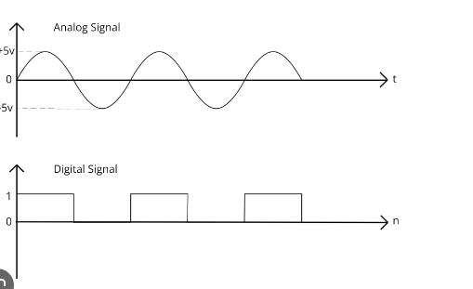
Analog signal:
An analog signal is a continuous representation of a physical quantity that varies over time.

Slide 68
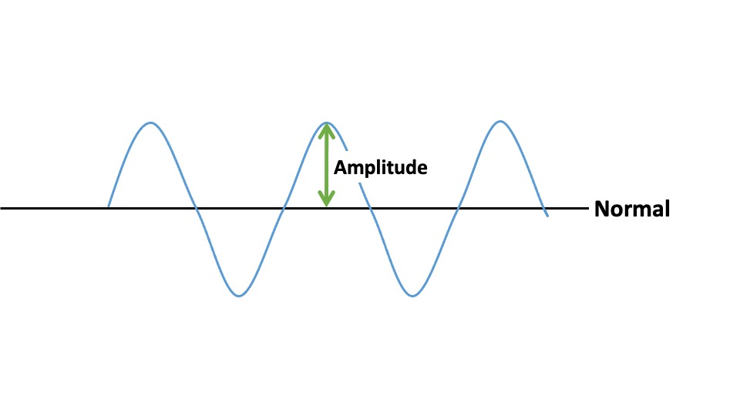
Digital Signal:
A digital signal is a signal that represents data as a sequence of discrete values.
Amplitude:
Amplitude refers to the maximum displacement of a wave from its mean position. In simpler terms, it's the height of the wave.

Slide 69
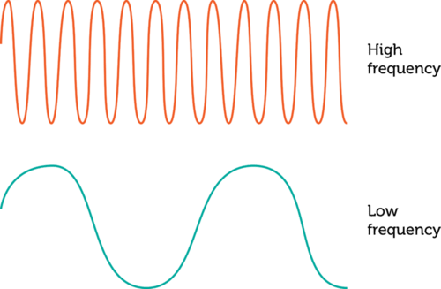
Frequency:
Frequency describes the number of waves that pass a fixed place in a given amount of time.

Slide 70
Phase
"phase" refers to the relative timing or position of a waveform compared to a reference waveform.
Bandwidth:
bandwidth refers to the data transfer rate of a network connection. It represents the maximum amount of data that can be transmitted over the network in a given amount of time and is typically measured in bits per second (bps) or multiples such as kilobits per second (kbps), megabits per second (Mbps), or gigabits per second (Gbps).

